Slide 1
The prediction: 11 DC restaurants will receive Michelin stars
Restaurant | Predicted | Actual
Fiola | 1 | 1
Corduroy | 1 | 0
Minibar | 3 | 2
Marcel’s | 1 | 0
Plume | 1 | 1
Komi | 2 | 0
Fiola Mare | 1 | 0
Sushi Taro | 1 | 1
Nora | 1 | 0
Obelisk | 1 | 0
Sakedokoro Makoto | 1 | 0
Ones I Missed Restaurant | Actual
Inn at Little Washington | 2
Blue Duck Tavern | 1
The Dabney | 1
Kinship | 1
Masseria | 1
Rose’s Luxury | 1
Tail Up Goat | 1
Pineapple & Pearls | 2

Slide 2
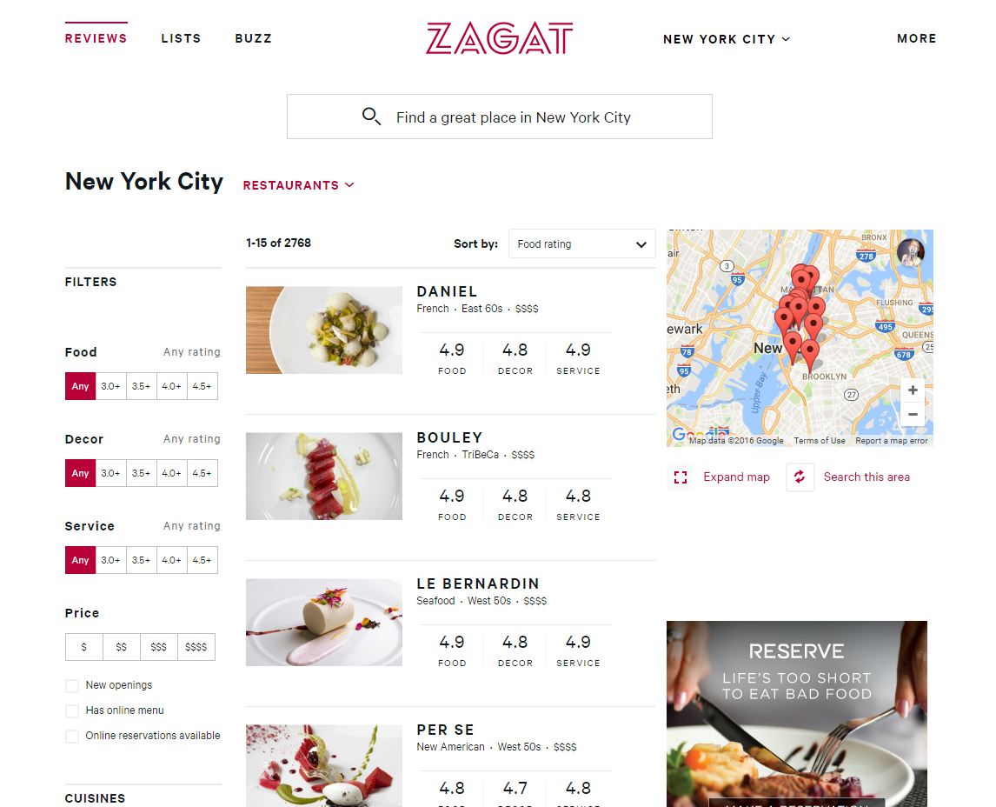
Variables
Cost
Cuisine
On open table?
Price level ($ - $$$$)
Food rating
Decor rating
Service rating
Notes:
Why Zagat?
Most Michelin restaurants are Zagat-rated
There are 3 US cities with Michelin stars – NYC, SF and Chicago. Zagat ratings exist in all three and in DC
I wanted to use something different than Yelp
How? Webscraping. I built a scraper to iterate through all these pages and pull restaurant data. I got data on over 2500 restaurants in NYC, 2000 in SF, and 1300 in Chicago.

Slide 3
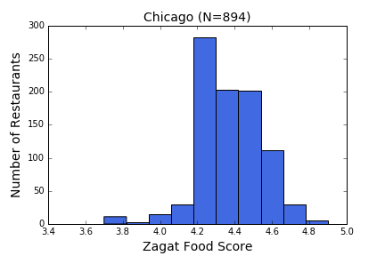
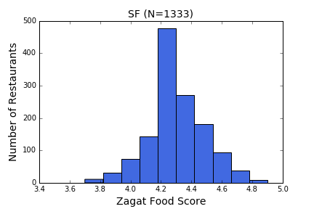
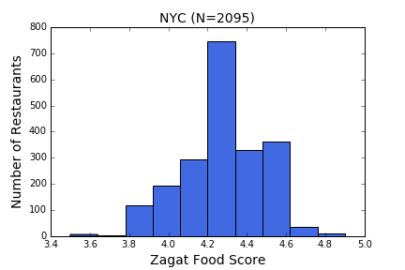
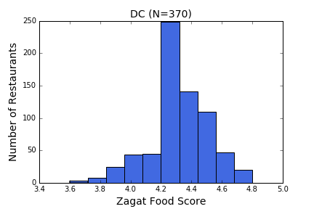
Across cities, Zagat food ratings spiked at 4.2
Notes:
I started with exploratory analysis to inform my modeling. Here’s something I noticed about the Zagat food ratings…

Slide 4
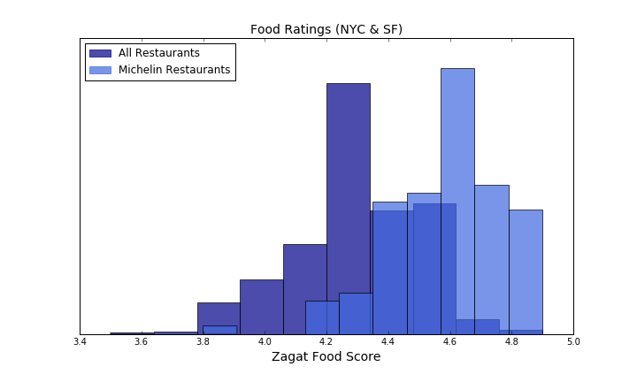
Michelin Restaurants have high Zagat food ratings
Notes:
As you can see, almost all Michelin restaurants included here have Zagat food scores over that 4.2 cutoff point
Because of this, I actually omitted all of the restaurants with a food rating below 4.2 in my modeling.

Slide 5
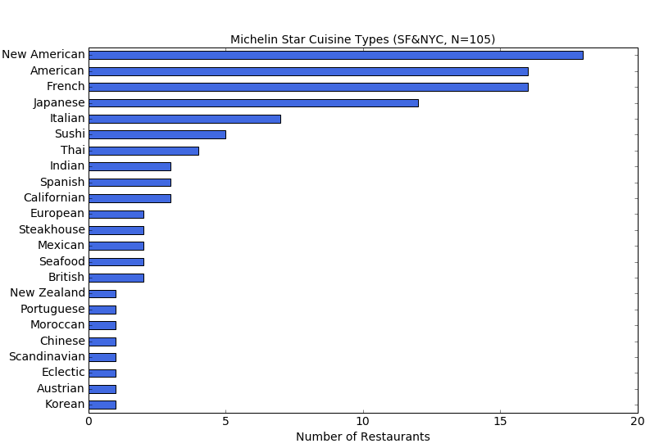
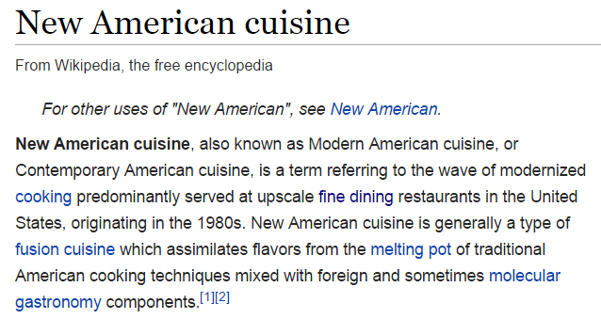
Certain cuisines receive Michelin stars more often

Slide 6
Michelin restaurants are more likely to be on Open Table

Slide 7
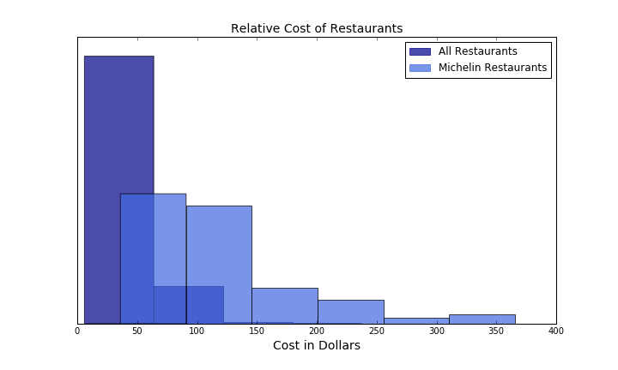
Michelin restaurants are also much more expensive
*Cost is cut off at $400 for visibility; some restaurants exceed this cost
Notes:
So, knowing that price is going to be important for a model in figuring out probability of being a Michelin restaurant… you have to think about different prices in different cities.

Slide 8
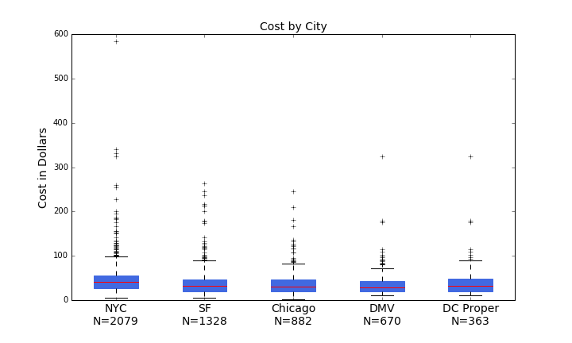
Some restaurants get really expensive…
Minibar!

Slide 9
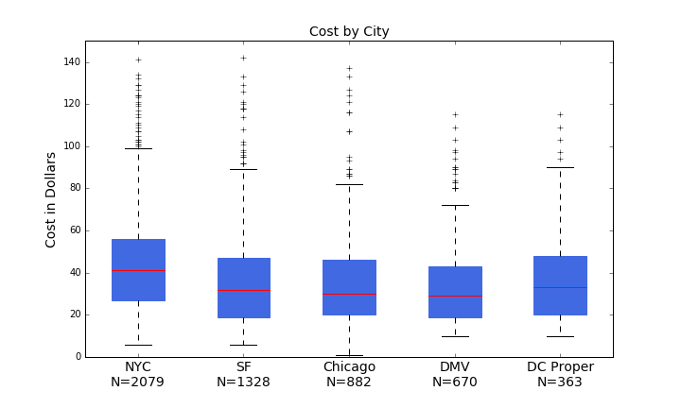
Prices vary across cities
Notes:
Normalized prices within cities
So now I’m at the point of picking a model.

Slide 10
Picking a model that makes sense with this data…
Variable | Transformations | Considerations
Cost | Scaled within cities | Continuous data
Cuisine | Label encoded | Categorical data
Open Table? | Coded as 0/1 | Dummy variable
$ - $$$$ | Coded 1 - 4 | Ordinal…but I’m treating like continuous
Zagat ratings (3 categories) | None | Ordinal?
Michelin Stars | None | Ordinal
Notes:
Normalized prices within cities
So now I’m at the point of picking a model, and this is slightly tricky data…

Slide 11
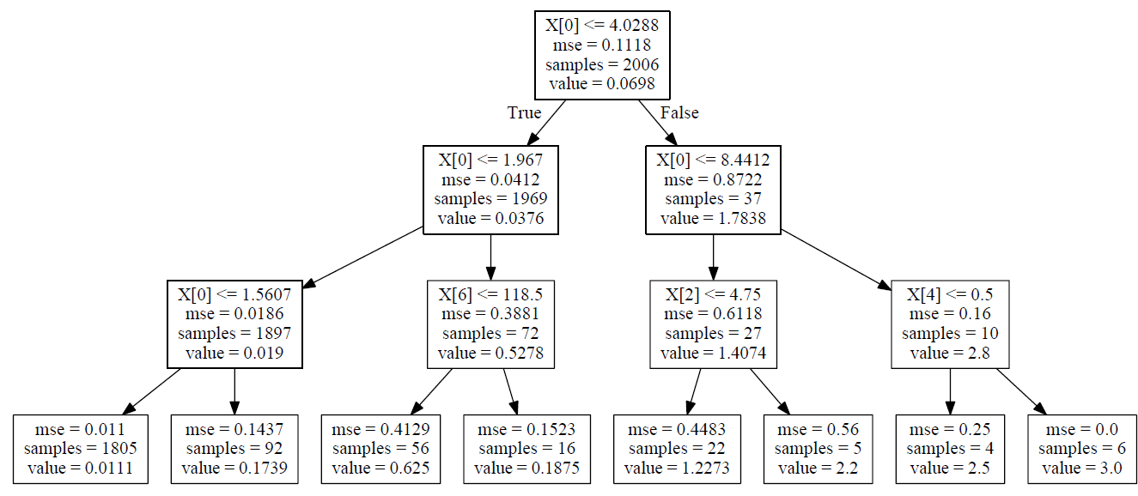
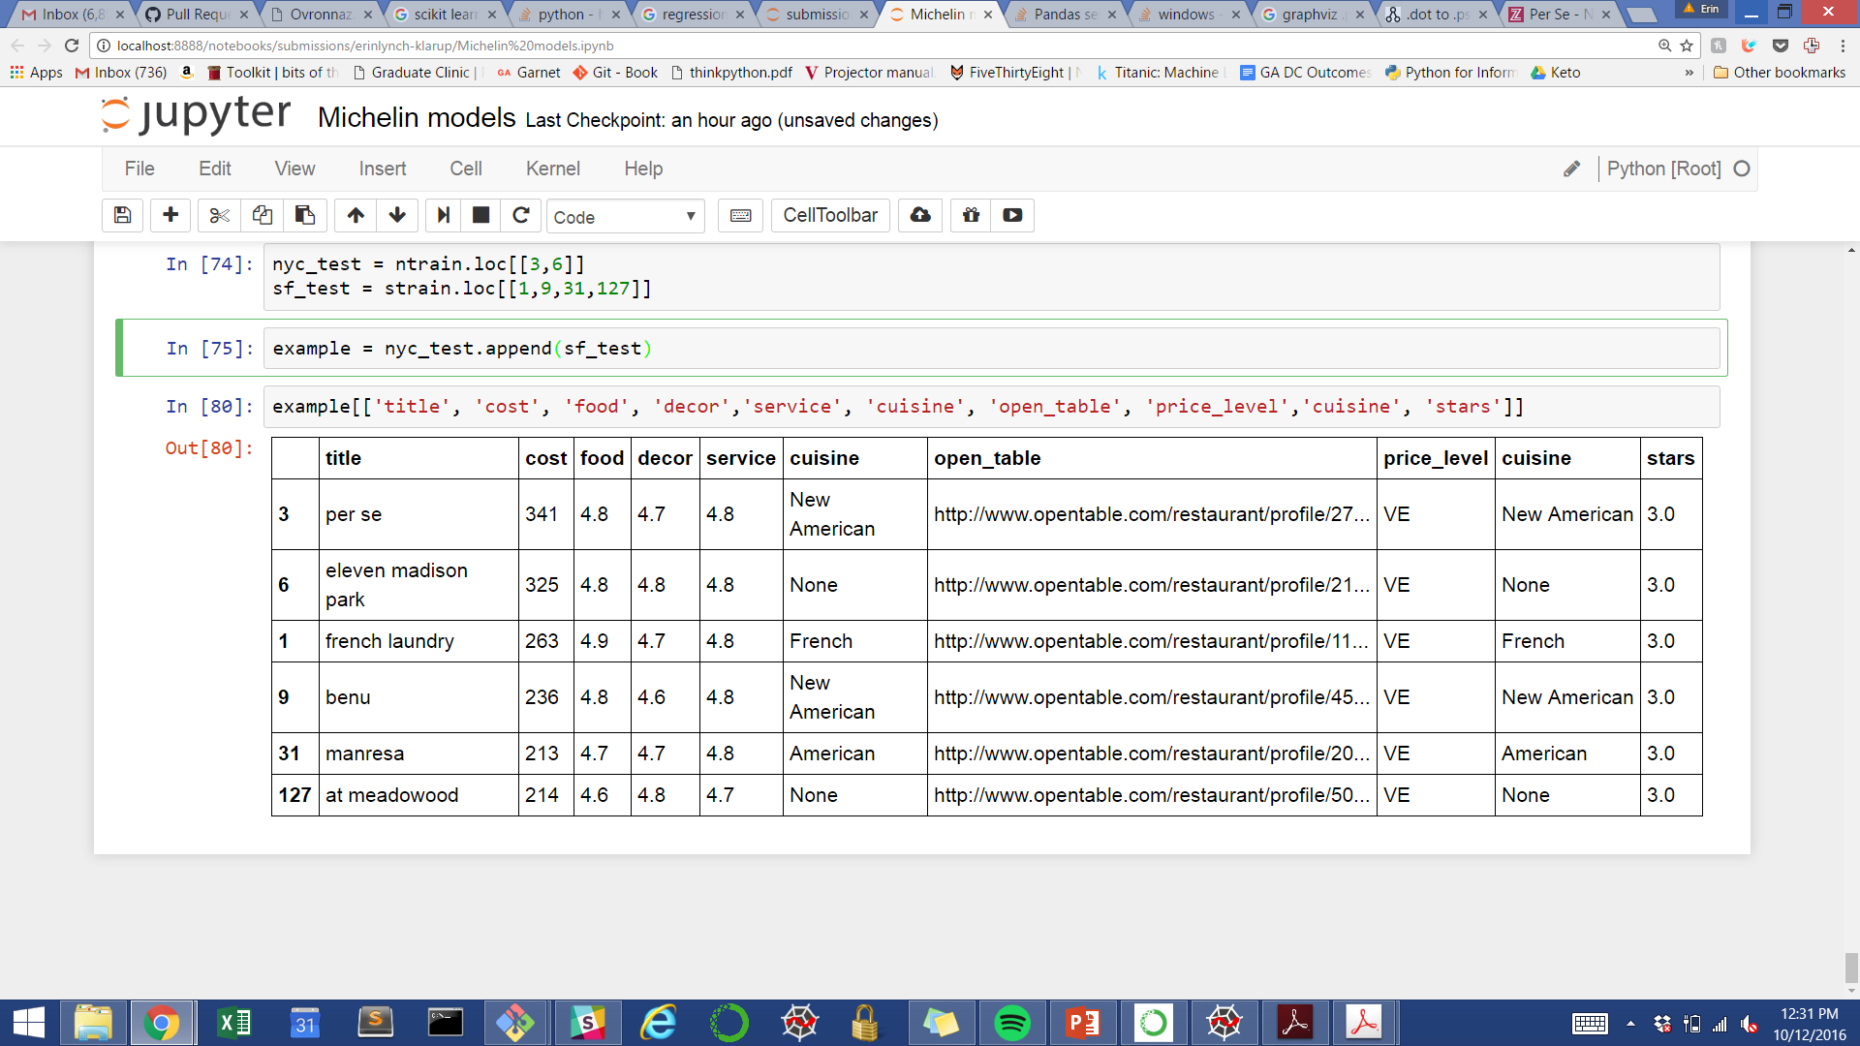
Random forest model
X[ ] | Variable
0 | cost
1 | food
2 | decor
3 | service
4 | ot_dummy
5 | price_lev_map
6 | cuisine_code
Example regression tree with training data
Notes:
Decision criterion is MSE – so the regression tree is making these splits to try to reduce the distance from the mean – its try to group the restaurants with very similar star values

Slide 12
Cost was by far the most important model feature

Slide 13
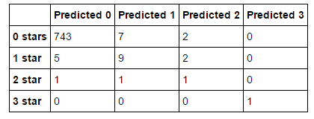
Model tested in Chicago
Best Model Results in Chicago
Notes:
rfg = RandomForestRegressor(100, max_depth=8)
Cost is normalized, cutoff is 4.2 food score for restaurants

Slide 14
Appendix

Slide 15
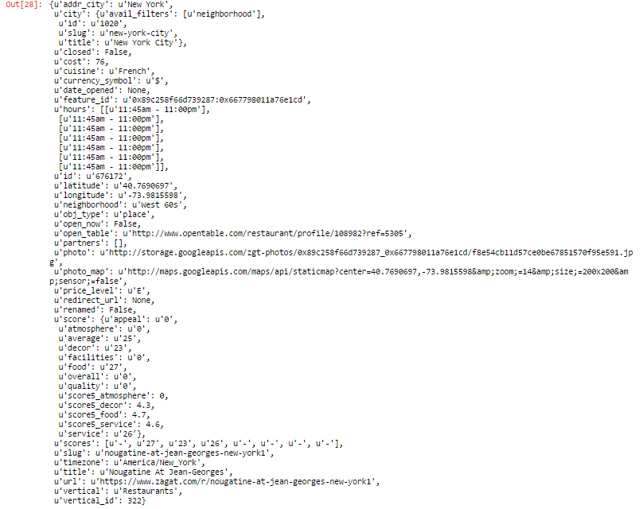
Sample JSON code from NY restaurant

Slide 16
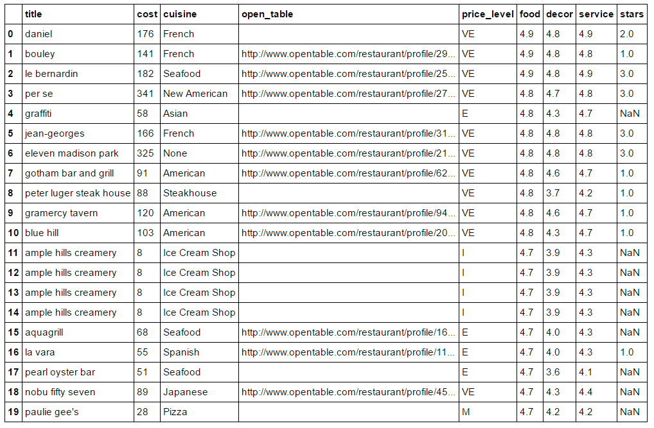
Notes:
Raw data

